Slide 1
ANZ Transaction Data
Aditya M.

Slide 2
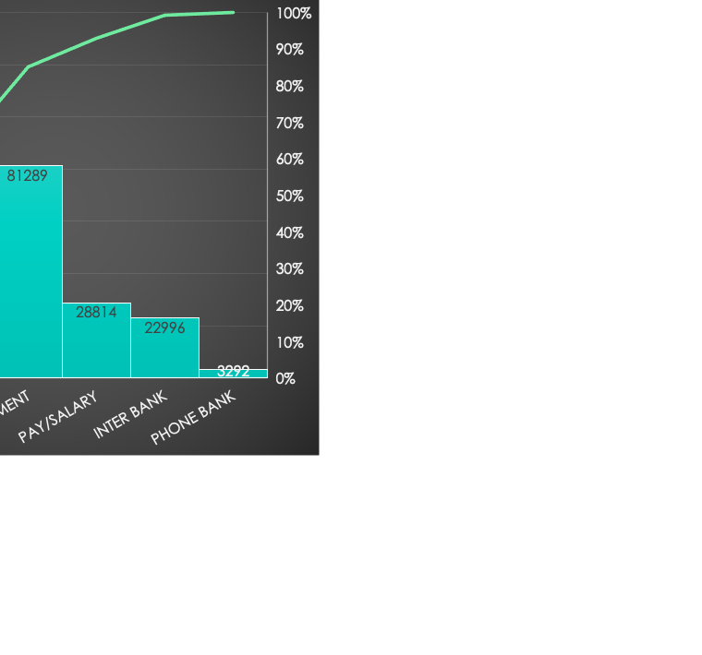
General Statistics
$187.93 | AVG Transaction Amount
$1,898.73 | AVG transaction amount when credit is used
$52.57 | AVG transaction amount when debit is used
$205.72 | AVG transaction amount when male
$168.52 | AVG transaction amount when female
$2,096.81 | AVG Transaction when male and credit is used
$54.98 | AVG Transaction when male and debit is used
$1,679.37 | AVG Transaction when female and credit is used
$49.95 | AVG Transaction when female and debit is used

Slide 3
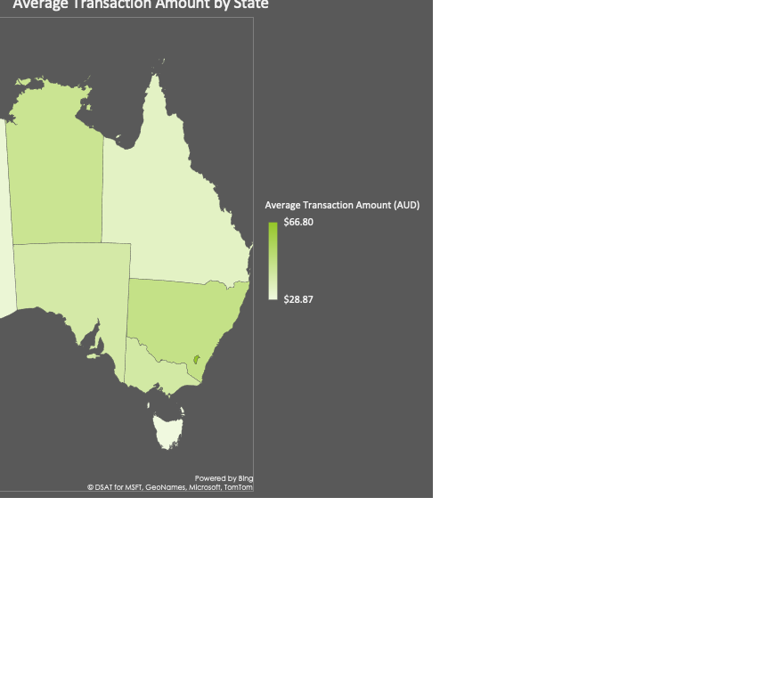
Location Analysis
From a total sample size of 7717.
States | Average Transaction Amount (AUD)
ACT | $ 66.80
NSW | $ 47.04
NT | $ 44.73
VIC | $ 41.10
SA | $ 40.43
QLD | $ 34.37
WA | $ 30.90
TAS | $ 28.87

Slide 4

Age Analysis

Slide 5
Time Series

